Slide 1
ODF Converter
Principles and Framework of the Converter
Clever Age
February 2007

Slide 2

Agenda
Principles
Problematic
Solution
Post-Processing
SW Components
Logical View
Project View
Framework Extension
Converter Project
Converter Class
Post-Processors
XSL Documents
Add-In Project

Slide 3
Principles > Problematic
Standard XSL Transform
Single input (XML)
Transform sheets (XSL) available on disk
Single output (XML)
Foo.xml
XSL Transform
Bar.xml
fooBar.xsl
fooBar.xsl
fooBar.xsl
FooBar.xsl

Slide 4
Principles > Problematic (2)
In ODF Translator:
Multiple input files (in Zip archive)
Multiple transform sheets (in binaries)
Multiple output files (in Zip archive)
Zip Archive
XSL Transform
Zip Archive
Foo.xml
Bar.xml
Foo.xml
Bar.xml
Foo.xml
Bar.xml
Foo.xml
Bar.xml
Binaries
fooBar.xsl
fooBar.xsl
fooBar.xsl
FooBar.xsl
Notes:
The

Slide 5
Principle > Problematic (3)
Sheer XSL code does not allow to :
Read from a Zip archive
Fetch nested stylesheets from binaries
Serialize the output into a Zip archive
Zip Archive
XSL Transform
Zip Archive
Foo.xml
Bar.xml
Foo.xml
Bar.xml
Foo.xml
Bar.xml
Foo.xml
Bar.xml
Binaries
fooBar.xsl
fooBar.xsl
fooBar.xsl
FooBar.xsl

Slide 6
Principles > Solution (1)
Use of a single input file (XML)¹
The xml files to convert are fetched by the stylesheet using the standard document() function.
Files in Zip archives and binaries are fetched via “Resolvers”²
The output stream is serialized in a zip archive via post-processors³.
The post-processors also perform more complex tasks⁴
Notes:
Notes:
This file is empty and is only use to “feed” the XSL transformer an input file.
Implement the XmlUrlResolver Class from the .NET Framework.
Implementing the XmlWriter class.
Tasks range from Space & reverse characters processing and are application specific.

Slide 7
Principles > Solution (2)
XSL Transform
Post-
processors
Zip Archive
source.xml
(dummy)
Post-
processors
Post-
processors
Bar.xml
Bar.xml
Bar.xml
Bar.xml
document()
odf2oox.xsl
<xsl:import/>
ZIP Resolver
Resource
Resolver
Zip Archive
Binaries
Foo.xml
fooBar.xsl
Foo.xml
fooBar.xsl
Foo.xml
fooBar.xsl
Foo.xml
FooBar.xsl

Slide 8
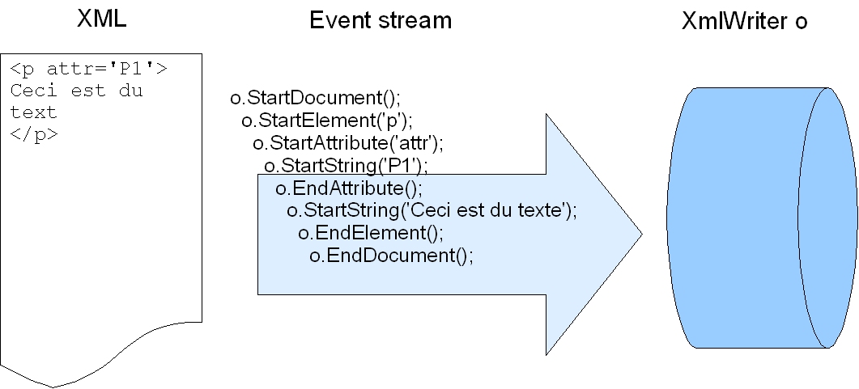
Principles > Post-Processing
Unlike XSLT, post processors are event driven components (.NET System.Xml.XmlWriter).
Pros : Allows fast - on the flight - XML processing.
Cons : Tedious low-level programming. Hard to debug and maintain.

Slide 9
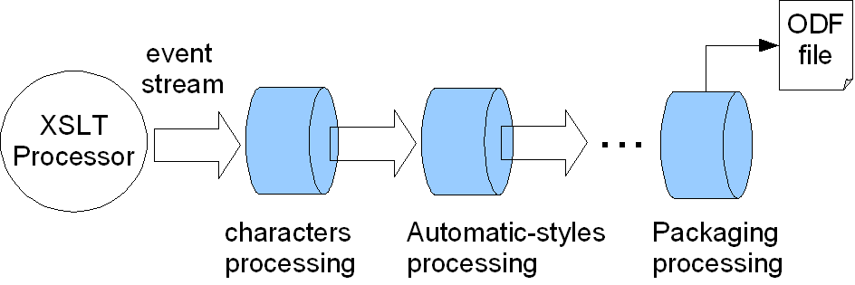
Principles > Post-Processing (2)
Multiple post processors are chained (assembly line).
Each processor’s output is the input of the following.
The last processor is the ZipArchiveWriter

Slide 10
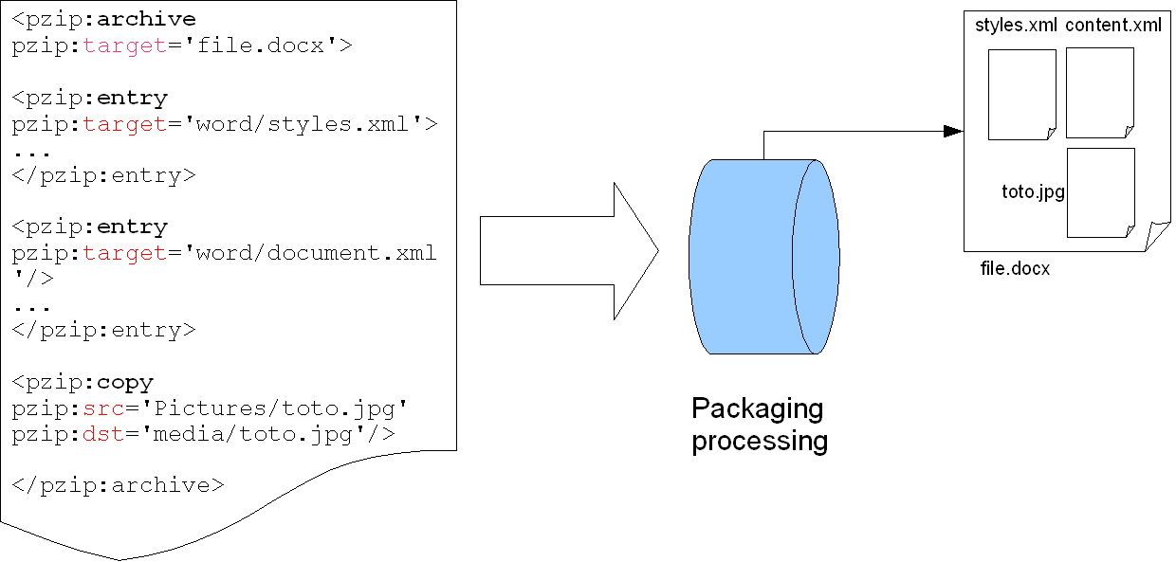
Principles > Post-Processing (3)
The last processor serializes the event stream into a ZIP archive.
The way XML parts & binaries are zipped together in the end is described by specific XML markup instructions. The ZipArchiveWriter component processes these instructions.
Notes:
*Xsl Commands
pzip:entry: Creates new file inside the archive
pZip:archive: Creates the archive
pzip:copy: Copies a resource inside the archive (e.g. an image)
Xsl Documents
Oox2odf .xsl & Odf2oox.xsl: entry; archive
Any xsl: copy.

Slide 11
SW Components > Logical View
.NET Framework
ZLib
Legend
ODF Zip Utilities
External components
ODF Converter Library
Common
components
ODF Add-In Library
Sub-components
Word
Excel
PowerPoint
Processor
Processor
Processor
Application specific
components
Add-In
Add-In
Add-In
Setup
Sub components
Setup
Setup
Shell Tools
Launcher¹
Command Line Tool¹
Notes:
Detailed Description of each component here!
Description
ODFZipUtils: zipArchiveWriter & zipReader implementations.
ODF Converter Library: implements the whole transformation processing chain in both directions (implements the resolvers, the common post-processors, & instantiates the XSL transformation engine)
ODF Add-In Library: Common code to the Add-In (implements the converter dialog boxes, manages message events & initiates conversion)
Word/Excel/PowerPoint
Processor: contains the xsl transform documents and post-processors.
Add-In: Implementation of the MS Office application COM interface (Loading/Unloading of the plugin, response to user events).
Setup: Installation utilities.
Launcher¹: A utility allowing the user to convert (and open) a ODF document directly from windows explorer.
Command Line Tool¹: A command line tool utility.
Notes:
Those utilities only use the processor sub-components from the application layer.

Slide 12
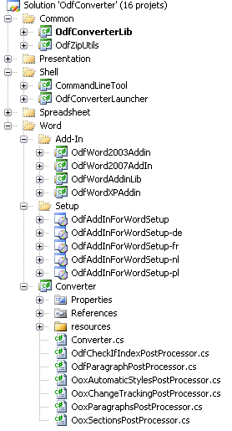
SW Components > Project View
Common: Common Components
Common XSLT
Post-processors
Conversion engine
Shell: Shell Tools
Launcher
Command Line Tool
Word/etc…: Application specific projects
Setup: Install Projects
Add-In: COM interface projects
Converter: Conversion project
Notes:
Mapping with SW Components: See also Readme file…
Note
(*) Define here the list of post-processors & Validators
TODO: Explain how validation is performed…

Slide 13
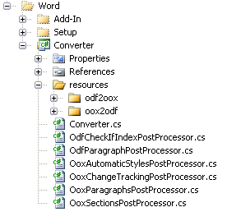
Framework Extension > Converter Project
Spreadsheet, Presentation and Wordprocessing specific conversion material should be composed of :
A Converter class
Postprocessors (optional)
XSL resources

Slide 14
Framework Extension > Converter Class
For the sake of reusability, Converter classes should inherit from a base class¹ (which already contains all the conversion engine) and may define the following method/properties:
DirectPostProcessorsChain & ReversePostProcessorsChain : Define the sequence of direct/reverse post-processors²
CheckOoxFile()³ & CheckOdfFile()³ : define the algorithm used to check the input files. For instance checks for encryption, MIME type, and manifest consistency.
Notes:
Notes:
CleverAge.OdfConverter.OdfConverterLib. AbstractConverter
Each post-processor should be defined with namespace.
Optional

Slide 15
Framework Extension > Post-Processors
Post-processors may implement AbstractPostProcessor¹ and must provide a one argument (XmlWriter nextWriter) constructor.
The post processors chain is automatically instantiated behind the scenes. It is wired to the XSLT processor’s output on one end, and to the ZipArchiveWriter on the other.
The following common post-processors may be reused :
OdfSpacesPostProcessor²
OoxSpacesPostProcessor
OdfCharactersPostProcessor
OoxCharactersPostProcessor
Notes:
Notes:
CleverAge.OdfConverter.OdfConverterLib. AbstractPostProcessor (acts as an adapter class, actually)
All common post-processors belong to the namespace CleverAge.OdfConverter.OdfConverterLib

Slide 16
Framework Extension > XSL documents (1)
The framework’s resource resolver will look for xsl stylesheets located in the following folders¹:
resources/odf2oox/ (direct conversion)
resources/oox2odf/ (reverse conversion)
The parent stylesheet must be named :
odf2oox.xsl (direct conversion)
oox2odf.xsl (reverse conversion)
odf2oox-compute-size.xsl (direct conversion size compute)
oox2odf-compute-size.xsl (reverse)
The following files are mandatory:
source.xml (input XML document stub)
Notes:
Notes:
Of the Converter Project

Slide 17
Framework Extension > XSL documents (2)
Shared XSL stylesheets (located in OdfConverterLib) may be imported as any other stylesheet.
Unlike ODF, OOX defines different XML schemas for features common to Word, Presentation and Spreadsheet! Exception for DrawingML code.
Therefore, conversion logic re-usability is poor, except for:
Lengths conversion routines (measures.xsl)
Shapes from the DrawingML specification part (TBD)¹
Some part-relationships (pictures, hyperlinks, embedded objects) (TBD)²
TextBox (TBD)³
…⁴
Notes:
Notes:
Not implemented yet. Should be done by Sonata
The templates need to be factorize. Also, this is about the relationship, not the reference!...
Code cannot be re-use yet on the reverse conversion (i.e. OOX -> ODF) as MS Office encodes all textboxes in VML format. The other applications use drawingML format.
Some features to be investigated.

Slide 18
Framework Extension > Add-In Project
The Add-In Project contains labels specific to the application.
Define a class implementing abstractAddIn.
Labels (.resx files) must be saved under the resource directory.
For now, common labels have to be duplicated (work in progress).

